Slide 1



Real-time evaluation of gap flushing in
electrical discharge machining
Alexander Goodlet & Philip Koshy
McMaster University
Canada
Cape Town
Notes:
This file is a template for making effective slides for scientific presentations.* Although much about the layout and typography contrasts sharply with the defaults of PowerPoint, these changes are done so to make the slides more effective at communicating technical information. The design advocated by this template arises from pages 113-152 of The Craft of Scientific Presentations (Springer, 2003). The homepage for this and other similar templates exist at the following web site:
http://writing.eng.vt.edu/slides.html
Right now you are viewing the notes pages. To work on the slides, click on “Slide” under “View.”
Reference slide: Katrina Aspmo, Torunn Berg, and Grethe Wibetoe, “Atmospheric Mercury Depletion Events (AMDEs) in Polar Regions During Arctic Spring,” presentation (Oslo, Norway: University of Oslo, 16 June 2004).
___________________________________________
*You are more than welcome to use this template for your presentation slides. You may not, though, distribute this template for profit or distribute this template without giving credit to the source.

Slide 2
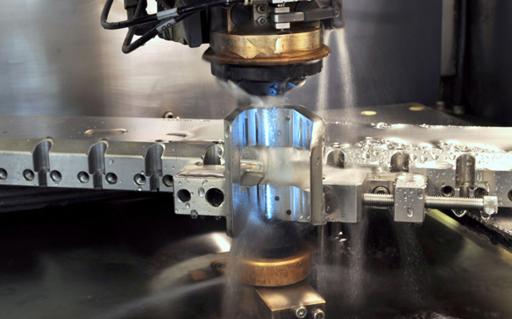
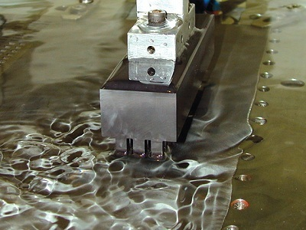
Flushing is arguably the most important factor that determines productivity and surface quality in EDM
njpt.com
Pressure and flow rate do not necessarily reflect the extent of useful dielectric flow in the working gap
Belmont
Belmont
Real-time evaluation of gap flushing in electrical discharge machining
A. Goodlet, P. Koshy
65th CIRP General Assembly
Cape Town, August 26, 2015
Notes:
This file is a template for making effective slides for scientific presentations.* Although much about the layout and typography contrasts sharply with the defaults of PowerPoint, these changes are done so to make the slides more effective at communicating technical information. The design advocated by this template arises from pages 113-152 of The Craft of Scientific Presentations (Springer, 2003). The homepage for this and other similar templates exist at the following web site:
http://writing.eng.vt.edu/slides.html
Right now you are viewing the notes pages. To work on the slides, click on “Slide” under “View.”
Reference slide: Katrina Aspmo, Torunn Berg, and Grethe Wibetoe, “Atmospheric Mercury Depletion Events (AMDEs) in Polar Regions During Arctic Spring,” presentation (Oslo, Norway: University of Oslo, 16 June 2004).
___________________________________________
*You are more than welcome to use this template for your presentation slides. You may not, though, distribute this template for profit or distribute this template without giving credit to the source.

Slide 3
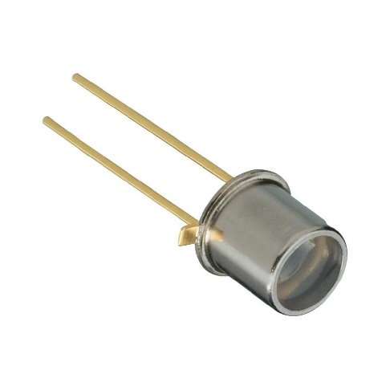
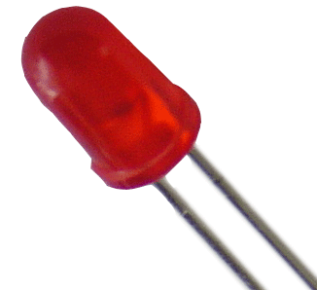
Measurement of gap contamination based on absorption of a light beam in the dielectric fluid
Jeswani (1981)
photodiode
light source
dielectric fluid
Real-time evaluation of gap flushing in electrical discharge machining
A. Goodlet, P. Koshy
65th CIRP General Assembly
Cape Town, August 26, 2015
Notes:
This file is a template for making effective slides for scientific presentations.* Although much about the layout and typography contrasts sharply with the defaults of PowerPoint, these changes are done so to make the slides more effective at communicating technical information. The design advocated by this template arises from pages 113-152 of The Craft of Scientific Presentations (Springer, 2003). The homepage for this and other similar templates exist at the following web site:
http://writing.eng.vt.edu/slides.html
Right now you are viewing the notes pages. To work on the slides, click on “Slide” under “View.”
Reference slide: Katrina Aspmo, Torunn Berg, and Grethe Wibetoe, “Atmospheric Mercury Depletion Events (AMDEs) in Polar Regions During Arctic Spring,” presentation (Oslo, Norway: University of Oslo, 16 June 2004).
___________________________________________
*You are more than welcome to use this template for your presentation slides. You may not, though, distribute this template for profit or distribute this template without giving credit to the source.

Slide 4
Assessment of dielectric state in terms of average ignition time delay for a given field intensity
Frei et al. (1987)
V
test cell
t_{d}
dielectric fluid
t
Jeswani & Frei et al. did not consider the role of gas bubbles
Real-time evaluation of gap flushing in electrical discharge machining
A. Goodlet, P. Koshy
65th CIRP General Assembly
Cape Town, August 26, 2015
Notes:
This file is a template for making effective slides for scientific presentations.* Although much about the layout and typography contrasts sharply with the defaults of PowerPoint, these changes are done so to make the slides more effective at communicating technical information. The design advocated by this template arises from pages 113-152 of The Craft of Scientific Presentations (Springer, 2003). The homepage for this and other similar templates exist at the following web site:
http://writing.eng.vt.edu/slides.html
Right now you are viewing the notes pages. To work on the slides, click on “Slide” under “View.”
Reference slide: Katrina Aspmo, Torunn Berg, and Grethe Wibetoe, “Atmospheric Mercury Depletion Events (AMDEs) in Polar Regions During Arctic Spring,” presentation (Oslo, Norway: University of Oslo, 16 June 2004).
___________________________________________
*You are more than welcome to use this template for your presentation slides. You may not, though, distribute this template for profit or distribute this template without giving credit to the source.

Slide 5
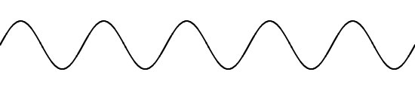


Transmission of ultrasonic waves decreases monotonically with an increase in the volume fraction of gas in the gap
Imai et al. (2001)
gas bubbles
ultrasonic
tool
work
ultrasonic
dielectric fluid
The technique is however insensitive to metallic debris
Real-time evaluation of gap flushing in electrical discharge machining
A. Goodlet, P. Koshy
65th CIRP General Assembly
Cape Town, August 26, 2015
Notes:
This file is a template for making effective slides for scientific presentations.* Although much about the layout and typography contrasts sharply with the defaults of PowerPoint, these changes are done so to make the slides more effective at communicating technical information. The design advocated by this template arises from pages 113-152 of The Craft of Scientific Presentations (Springer, 2003). The homepage for this and other similar templates exist at the following web site:
http://writing.eng.vt.edu/slides.html
Right now you are viewing the notes pages. To work on the slides, click on “Slide” under “View.”
Reference slide: Katrina Aspmo, Torunn Berg, and Grethe Wibetoe, “Atmospheric Mercury Depletion Events (AMDEs) in Polar Regions During Arctic Spring,” presentation (Oslo, Norway: University of Oslo, 16 June 2004).
___________________________________________
*You are more than welcome to use this template for your presentation slides. You may not, though, distribute this template for profit or distribute this template without giving credit to the source.

Slide 6
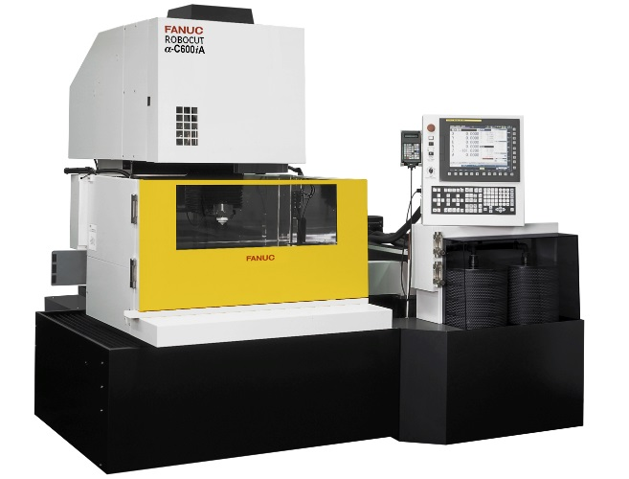
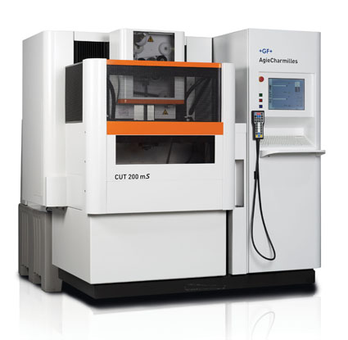
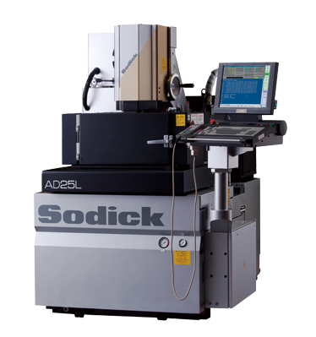
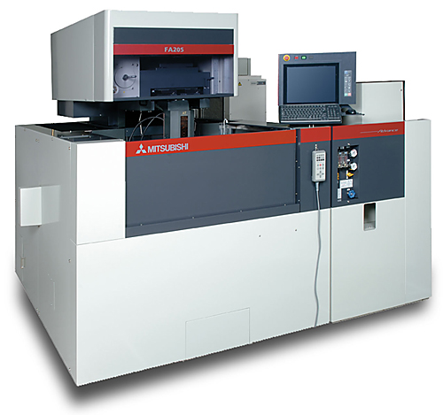
There is a need for a technique for the in-process monitoring of gap flushing in EDM, which can be easily integrated into machine tools
Real-time evaluation of gap flushing in electrical discharge machining
A. Goodlet, P. Koshy
65th CIRP General Assembly
Cape Town, August 26, 2015
Notes:
This file is a template for making effective slides for scientific presentations.* Although much about the layout and typography contrasts sharply with the defaults of PowerPoint, these changes are done so to make the slides more effective at communicating technical information. The design advocated by this template arises from pages 113-152 of The Craft of Scientific Presentations (Springer, 2003). The homepage for this and other similar templates exist at the following web site:
http://writing.eng.vt.edu/slides.html
Right now you are viewing the notes pages. To work on the slides, click on “Slide” under “View.”
Reference slide: Katrina Aspmo, Torunn Berg, and Grethe Wibetoe, “Atmospheric Mercury Depletion Events (AMDEs) in Polar Regions During Arctic Spring,” presentation (Oslo, Norway: University of Oslo, 16 June 2004).
___________________________________________
*You are more than welcome to use this template for your presentation slides. You may not, though, distribute this template for profit or distribute this template without giving credit to the source.

Slide 7
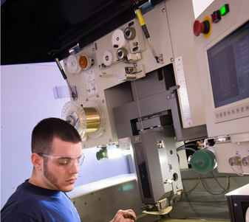
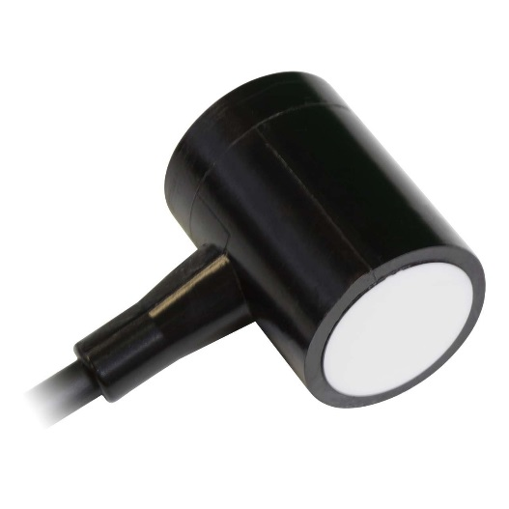
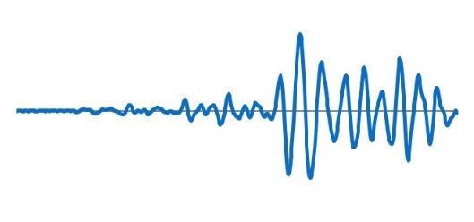
AE sensor
gemmfg.com
The present work demonstrates the application of acoustic emission for the real-time quantification, monitoring and optimization of gap flushing
Real-time evaluation of gap flushing in electrical discharge machining
A. Goodlet, P. Koshy
65th CIRP General Assembly
Cape Town, August 26, 2015
Notes:
This file is a template for making effective slides for scientific presentations.* Although much about the layout and typography contrasts sharply with the defaults of PowerPoint, these changes are done so to make the slides more effective at communicating technical information. The design advocated by this template arises from pages 113-152 of The Craft of Scientific Presentations (Springer, 2003). The homepage for this and other similar templates exist at the following web site:
http://writing.eng.vt.edu/slides.html
Right now you are viewing the notes pages. To work on the slides, click on “Slide” under “View.”
Reference slide: Katrina Aspmo, Torunn Berg, and Grethe Wibetoe, “Atmospheric Mercury Depletion Events (AMDEs) in Polar Regions During Arctic Spring,” presentation (Oslo, Norway: University of Oslo, 16 June 2004).
___________________________________________
*You are more than welcome to use this template for your presentation slides. You may not, though, distribute this template for profit or distribute this template without giving credit to the source.

Slide 8
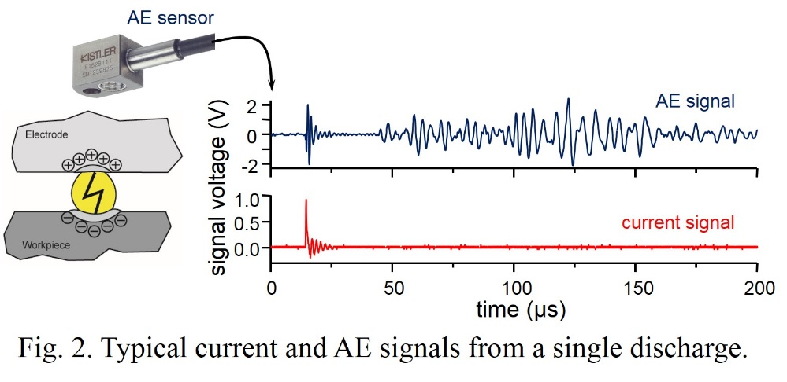
The nature of acoustic emission in EDM as it relates to fundamental process mechanisms pertinent to gap flushing is also presented
Real-time evaluation of gap flushing in electrical discharge machining
A. Goodlet, P. Koshy
65th CIRP General Assembly
Cape Town, August 26, 2015
Notes:
This file is a template for making effective slides for scientific presentations.* Although much about the layout and typography contrasts sharply with the defaults of PowerPoint, these changes are done so to make the slides more effective at communicating technical information. The design advocated by this template arises from pages 113-152 of The Craft of Scientific Presentations (Springer, 2003). The homepage for this and other similar templates exist at the following web site:
http://writing.eng.vt.edu/slides.html
Right now you are viewing the notes pages. To work on the slides, click on “Slide” under “View.”
Reference slide: Katrina Aspmo, Torunn Berg, and Grethe Wibetoe, “Atmospheric Mercury Depletion Events (AMDEs) in Polar Regions During Arctic Spring,” presentation (Oslo, Norway: University of Oslo, 16 June 2004).
___________________________________________
*You are more than welcome to use this template for your presentation slides. You may not, though, distribute this template for profit or distribute this template without giving credit to the source.

Slide 9
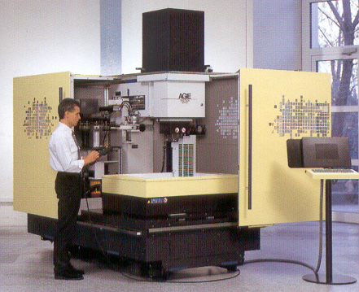
average voltage | 75 V
peak current | 4.4 A
polarity | copper disk tool (+)
pulse on-time | 154 µs
pulse off-time | 37 µs
machining area | 3.2 x 25.4 mm²
Rotating disk electrode provided quantifiable and consistent flushing
Real-time evaluation of gap flushing in electrical discharge machining
A. Goodlet, P. Koshy
65th CIRP General Assembly
Cape Town, August 26, 2015
Notes:
This file is a template for making effective slides for scientific presentations.* Although much about the layout and typography contrasts sharply with the defaults of PowerPoint, these changes are done so to make the slides more effective at communicating technical information. The design advocated by this template arises from pages 113-152 of The Craft of Scientific Presentations (Springer, 2003). The homepage for this and other similar templates exist at the following web site:
http://writing.eng.vt.edu/slides.html
Right now you are viewing the notes pages. To work on the slides, click on “Slide” under “View.”
Reference slide: Katrina Aspmo, Torunn Berg, and Grethe Wibetoe, “Atmospheric Mercury Depletion Events (AMDEs) in Polar Regions During Arctic Spring,” presentation (Oslo, Norway: University of Oslo, 16 June 2004).
___________________________________________
*You are more than welcome to use this template for your presentation slides. You may not, though, distribute this template for profit or distribute this template without giving credit to the source.

Slide 10
AE RMS scales with the material removal rate
AE has unique
information not present in the current signal
Real-time evaluation of gap flushing in electrical discharge machining
A. Goodlet, P. Koshy
65th CIRP General Assembly
Cape Town, August 26, 2015
Notes:
This file is a template for making effective slides for scientific presentations.* Although much about the layout and typography contrasts sharply with the defaults of PowerPoint, these changes are done so to make the slides more effective at communicating technical information. The design advocated by this template arises from pages 113-152 of The Craft of Scientific Presentations (Springer, 2003). The homepage for this and other similar templates exist at the following web site:
http://writing.eng.vt.edu/slides.html
Right now you are viewing the notes pages. To work on the slides, click on “Slide” under “View.”
Reference slide: Katrina Aspmo, Torunn Berg, and Grethe Wibetoe, “Atmospheric Mercury Depletion Events (AMDEs) in Polar Regions During Arctic Spring,” presentation (Oslo, Norway: University of Oslo, 16 June 2004).
___________________________________________
*You are more than welcome to use this template for your presentation slides. You may not, though, distribute this template for profit or distribute this template without giving credit to the source.

Slide 11
raw AE signal
insignificant AE at low speed
AE bursts at optimal speed
lower amplitude at higher speed
Pockets of time devoid of any AE activity signify discharge instability
Real-time evaluation of gap flushing in electrical discharge machining
A. Goodlet, P. Koshy
65th CIRP General Assembly
Cape Town, August 26, 2015
Notes:
This file is a template for making effective slides for scientific presentations.* Although much about the layout and typography contrasts sharply with the defaults of PowerPoint, these changes are done so to make the slides more effective at communicating technical information. The design advocated by this template arises from pages 113-152 of The Craft of Scientific Presentations (Springer, 2003). The homepage for this and other similar templates exist at the following web site:
http://writing.eng.vt.edu/slides.html
Right now you are viewing the notes pages. To work on the slides, click on “Slide” under “View.”
Reference slide: Katrina Aspmo, Torunn Berg, and Grethe Wibetoe, “Atmospheric Mercury Depletion Events (AMDEs) in Polar Regions During Arctic Spring,” presentation (Oslo, Norway: University of Oslo, 16 June 2004).
___________________________________________
*You are more than welcome to use this template for your presentation slides. You may not, though, distribute this template for profit or distribute this template without giving credit to the source.

Slide 12
2 minutes after gap was contaminated
gap artificially contaminated with metallic debris
baseline
Unlike the ultrasonic technique, AE is sensitive to metallic debris in the gap
Real-time evaluation of gap flushing in electrical discharge machining
A. Goodlet, P. Koshy
65th CIRP General Assembly
Cape Town, August 26, 2015
Notes:
This file is a template for making effective slides for scientific presentations.* Although much about the layout and typography contrasts sharply with the defaults of PowerPoint, these changes are done so to make the slides more effective at communicating technical information. The design advocated by this template arises from pages 113-152 of The Craft of Scientific Presentations (Springer, 2003). The homepage for this and other similar templates exist at the following web site:
http://writing.eng.vt.edu/slides.html
Right now you are viewing the notes pages. To work on the slides, click on “Slide” under “View.”
Reference slide: Katrina Aspmo, Torunn Berg, and Grethe Wibetoe, “Atmospheric Mercury Depletion Events (AMDEs) in Polar Regions During Arctic Spring,” presentation (Oslo, Norway: University of Oslo, 16 June 2004).
___________________________________________
*You are more than welcome to use this template for your presentation slides. You may not, though, distribute this template for profit or distribute this template without giving credit to the source.

Slide 13
AE amplitude scales also with the dielectric flow pressure
Real-time evaluation of gap flushing in electrical discharge machining
A. Goodlet, P. Koshy
65th CIRP General Assembly
Cape Town, August 26, 2015
Notes:
This file is a template for making effective slides for scientific presentations.* Although much about the layout and typography contrasts sharply with the defaults of PowerPoint, these changes are done so to make the slides more effective at communicating technical information. The design advocated by this template arises from pages 113-152 of The Craft of Scientific Presentations (Springer, 2003). The homepage for this and other similar templates exist at the following web site:
http://writing.eng.vt.edu/slides.html
Right now you are viewing the notes pages. To work on the slides, click on “Slide” under “View.”
Reference slide: Katrina Aspmo, Torunn Berg, and Grethe Wibetoe, “Atmospheric Mercury Depletion Events (AMDEs) in Polar Regions During Arctic Spring,” presentation (Oslo, Norway: University of Oslo, 16 June 2004).
___________________________________________
*You are more than welcome to use this template for your presentation slides. You may not, though, distribute this template for profit or distribute this template without giving credit to the source.

Slide 14
AE RMS is maximized at a current density of 10 A/cm², which is a rule of thumb used in EDM practice
Optimal current density decreases when flushing is non-optimal
Real-time evaluation of gap flushing in electrical discharge machining
A. Goodlet, P. Koshy
65th CIRP General Assembly
Cape Town, August 26, 2015
Notes:
This file is a template for making effective slides for scientific presentations.* Although much about the layout and typography contrasts sharply with the defaults of PowerPoint, these changes are done so to make the slides more effective at communicating technical information. The design advocated by this template arises from pages 113-152 of The Craft of Scientific Presentations (Springer, 2003). The homepage for this and other similar templates exist at the following web site:
http://writing.eng.vt.edu/slides.html
Right now you are viewing the notes pages. To work on the slides, click on “Slide” under “View.”
Reference slide: Katrina Aspmo, Torunn Berg, and Grethe Wibetoe, “Atmospheric Mercury Depletion Events (AMDEs) in Polar Regions During Arctic Spring,” presentation (Oslo, Norway: University of Oslo, 16 June 2004).
___________________________________________
*You are more than welcome to use this template for your presentation slides. You may not, though, distribute this template for profit or distribute this template without giving credit to the source.

Slide 15
Melting of workpiece during dry EDM discounted thermal origin of AE
Aligns with the finding of Kunieda et al. (2003) that discharges in a liquid dielectric correspond to a significantly higher force relative to those in air
Acoustic emission in EDM refers to the dynamics of gas bubbles in the gap
Real-time evaluation of gap flushing in electrical discharge machining
A. Goodlet, P. Koshy
65th CIRP General Assembly
Cape Town, August 26, 2015
Notes:
This file is a template for making effective slides for scientific presentations.* Although much about the layout and typography contrasts sharply with the defaults of PowerPoint, these changes are done so to make the slides more effective at communicating technical information. The design advocated by this template arises from pages 113-152 of The Craft of Scientific Presentations (Springer, 2003). The homepage for this and other similar templates exist at the following web site:
http://writing.eng.vt.edu/slides.html
Right now you are viewing the notes pages. To work on the slides, click on “Slide” under “View.”
Reference slide: Katrina Aspmo, Torunn Berg, and Grethe Wibetoe, “Atmospheric Mercury Depletion Events (AMDEs) in Polar Regions During Arctic Spring,” presentation (Oslo, Norway: University of Oslo, 16 June 2004).
___________________________________________
*You are more than welcome to use this template for your presentation slides. You may not, though, distribute this template for profit or distribute this template without giving credit to the source.

Slide 16
Not all discharges manifest an AE burst
Material removal rate decreases significantly as gas bubbles fill the gap − Imai et al. (2001)
For 2 consecutive discharges, the force from the 2nd discharge is insignificant, as it occurs through the gas bubble from the first discharge − Kunieda et al. (2003)
Hypothesis: acoustic burst relates to discharge initiated in a liquid, as opposed to in a gas bubble or at the gas-liquid interface
Real-time evaluation of gap flushing in electrical discharge machining
A. Goodlet, P. Koshy
65th CIRP General Assembly
Cape Town, August 26, 2015
Notes:
This file is a template for making effective slides for scientific presentations.* Although much about the layout and typography contrasts sharply with the defaults of PowerPoint, these changes are done so to make the slides more effective at communicating technical information. The design advocated by this template arises from pages 113-152 of The Craft of Scientific Presentations (Springer, 2003). The homepage for this and other similar templates exist at the following web site:
http://writing.eng.vt.edu/slides.html
Right now you are viewing the notes pages. To work on the slides, click on “Slide” under “View.”
Reference slide: Katrina Aspmo, Torunn Berg, and Grethe Wibetoe, “Atmospheric Mercury Depletion Events (AMDEs) in Polar Regions During Arctic Spring,” presentation (Oslo, Norway: University of Oslo, 16 June 2004).
___________________________________________
*You are more than welcome to use this template for your presentation slides. You may not, though, distribute this template for profit or distribute this template without giving credit to the source.

Slide 17
Should the hypothesis be true, the number of acoustic bursts per discharge should increase with the electrode peripheral speed, as the fluid flow expedites gas bubble evacuation from the gap …
… it does!
Real-time evaluation of gap flushing in electrical discharge machining
A. Goodlet, P. Koshy
65th CIRP General Assembly
Cape Town, August 26, 2015
Notes:
This file is a template for making effective slides for scientific presentations.* Although much about the layout and typography contrasts sharply with the defaults of PowerPoint, these changes are done so to make the slides more effective at communicating technical information. The design advocated by this template arises from pages 113-152 of The Craft of Scientific Presentations (Springer, 2003). The homepage for this and other similar templates exist at the following web site:
http://writing.eng.vt.edu/slides.html
Right now you are viewing the notes pages. To work on the slides, click on “Slide” under “View.”
Reference slide: Katrina Aspmo, Torunn Berg, and Grethe Wibetoe, “Atmospheric Mercury Depletion Events (AMDEs) in Polar Regions During Arctic Spring,” presentation (Oslo, Norway: University of Oslo, 16 June 2004).
___________________________________________
*You are more than welcome to use this template for your presentation slides. You may not, though, distribute this template for profit or distribute this template without giving credit to the source.

Slide 18
Similarly, the number of acoustic bursts per discharge should increase with pulse off-time, since there is more time available for the evacuation of gas bubbles from the gap …
… and it does again!
Real-time evaluation of gap flushing in electrical discharge machining
A. Goodlet, P. Koshy
65th CIRP General Assembly
Cape Town, August 26, 2015
Notes:
This file is a template for making effective slides for scientific presentations.* Although much about the layout and typography contrasts sharply with the defaults of PowerPoint, these changes are done so to make the slides more effective at communicating technical information. The design advocated by this template arises from pages 113-152 of The Craft of Scientific Presentations (Springer, 2003). The homepage for this and other similar templates exist at the following web site:
http://writing.eng.vt.edu/slides.html
Right now you are viewing the notes pages. To work on the slides, click on “Slide” under “View.”
Reference slide: Katrina Aspmo, Torunn Berg, and Grethe Wibetoe, “Atmospheric Mercury Depletion Events (AMDEs) in Polar Regions During Arctic Spring,” presentation (Oslo, Norway: University of Oslo, 16 June 2004).
___________________________________________
*You are more than welcome to use this template for your presentation slides. You may not, though, distribute this template for profit or distribute this template without giving credit to the source.

Slide 19
Similarly, introducing air into the gap reduces acoustic activity significantly
This conclusively proves the hypothesis that acoustic bursts correspond to discharges initiated in a liquid, as opposed to those in a gas bubble or at the gas-liquid interface
Real-time evaluation of gap flushing in electrical discharge machining
A. Goodlet, P. Koshy
65th CIRP General Assembly
Cape Town, August 26, 2015
Notes:
This file is a template for making effective slides for scientific presentations.* Although much about the layout and typography contrasts sharply with the defaults of PowerPoint, these changes are done so to make the slides more effective at communicating technical information. The design advocated by this template arises from pages 113-152 of The Craft of Scientific Presentations (Springer, 2003). The homepage for this and other similar templates exist at the following web site:
http://writing.eng.vt.edu/slides.html
Right now you are viewing the notes pages. To work on the slides, click on “Slide” under “View.”
Reference slide: Katrina Aspmo, Torunn Berg, and Grethe Wibetoe, “Atmospheric Mercury Depletion Events (AMDEs) in Polar Regions During Arctic Spring,” presentation (Oslo, Norway: University of Oslo, 16 June 2004).
___________________________________________
*You are more than welcome to use this template for your presentation slides. You may not, though, distribute this template for profit or distribute this template without giving credit to the source.

Slide 20
  Since discharges initiated through a liquid are generally more effective in removing material, acoustic emission encapsulates valuable information on process productivity, at the scale of single discharges
Kunieda et al. (2015)
  This information is unique, as it is not as readily obtained from the electrical waveforms
Real-time evaluation of gap flushing in electrical discharge machining
A. Goodlet, P. Koshy
65th CIRP General Assembly
Cape Town, August 26, 2015
Notes:
This file is a template for making effective slides for scientific presentations.* Although much about the layout and typography contrasts sharply with the defaults of PowerPoint, these changes are done so to make the slides more effective at communicating technical information. The design advocated by this template arises from pages 113-152 of The Craft of Scientific Presentations (Springer, 2003). The homepage for this and other similar templates exist at the following web site:
http://writing.eng.vt.edu/slides.html
Right now you are viewing the notes pages. To work on the slides, click on “Slide” under “View.”
Reference slide: Katrina Aspmo, Torunn Berg, and Grethe Wibetoe, “Atmospheric Mercury Depletion Events (AMDEs) in Polar Regions During Arctic Spring,” presentation (Oslo, Norway: University of Oslo, 16 June 2004).
___________________________________________
*You are more than welcome to use this template for your presentation slides. You may not, though, distribute this template for profit or distribute this template without giving credit to the source.

Slide 21
Conclusions
  Acoustic emission in EDM is sensitive to gap contamination from both metallic debris and gas bubbles
  Time-averaged acoustic emission scales with the material removal rate when flushing is varied, and is hence applicable for on-line determination of optimal flushing
  Acoustic emission constitutes a burst when the discharge is initiated through the liquid medium, as opposed to through a gas bubble or at the gas-liquid interface
  Acoustic emission have great potential for complementing electrical waveforms for process monitoring and control
Real-time evaluation of gap flushing in electrical discharge machining
A. Goodlet, P. Koshy
65th CIRP General Assembly
Cape Town, August 26, 2015
Notes:
This file is a template for making effective slides for scientific presentations.* Although much about the layout and typography contrasts sharply with the defaults of PowerPoint, these changes are done so to make the slides more effective at communicating technical information. The design advocated by this template arises from pages 113-152 of The Craft of Scientific Presentations (Springer, 2003). The homepage for this and other similar templates exist at the following web site:
http://writing.eng.vt.edu/slides.html
Right now you are viewing the notes pages. To work on the slides, click on “Slide” under “View.”
Reference slide: Katrina Aspmo, Torunn Berg, and Grethe Wibetoe, “Atmospheric Mercury Depletion Events (AMDEs) in Polar Regions During Arctic Spring,” presentation (Oslo, Norway: University of Oslo, 16 June 2004).
___________________________________________
*You are more than welcome to use this template for your presentation slides. You may not, though, distribute this template for profit or distribute this template without giving credit to the source.

Slide 22


Canadian Network for
Research & Innovation in
Machining Technology
Thank you
for your kind attention!
Natural Sciences & Engineering Research Council of Canada
Notes:
This file is a template for making effective slides for scientific presentations.* Although much about the layout and typography contrasts sharply with the defaults of PowerPoint, these changes are done so to make the slides more effective at communicating technical information. The design advocated by this template arises from pages 113-152 of The Craft of Scientific Presentations (Springer, 2003). The homepage for this and other similar templates exist at the following web site:
http://writing.eng.vt.edu/slides.html
Right now you are viewing the notes pages. To work on the slides, click on “Slide” under “View.”
Reference slide: Katrina Aspmo, Torunn Berg, and Grethe Wibetoe, “Atmospheric Mercury Depletion Events (AMDEs) in Polar Regions During Arctic Spring,” presentation (Oslo, Norway: University of Oslo, 16 June 2004).
___________________________________________
*You are more than welcome to use this template for your presentation slides. You may not, though, distribute this template for profit or distribute this template without giving credit to the source.

